Slide 1
Name: Gaurav Dhavale MIS 6345: Assignment 3

Slide 2
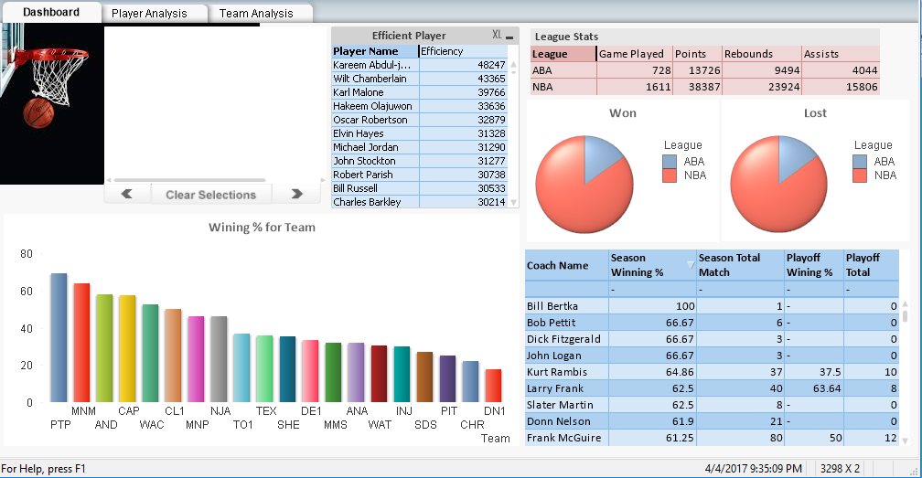
Dashboard:

Slide 3
Dashboard:
Current Selection with clear, back and forward selection is added to perform respected operations
Player efficiency is calculated by formula:
pts + reb + asts + stl + blk - ((fga - fgm) + (fta - ftm) + turnover…Source: Wikipedia
Players are arrange in descending order for efficiency value.
Bar Graph shows teams with their % of wining matches in descending order
League Stats shows maximum records achieved by players in respected
league
Pie Chart shows won and lost count for two leagues
Coach statistics are shown in last table.

Slide 4
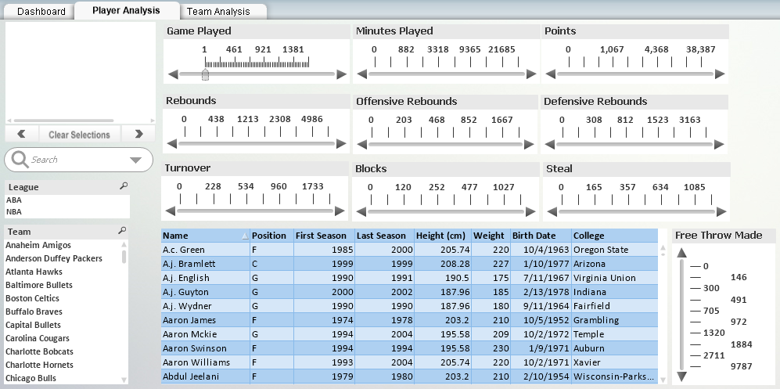
Player Analysis:

Slide 5
Player Analysis:
Current Selection with clear, back and forward selection is added to perform respected operations
Player information is shown in tabular format. This information can be filter based on different players statistics as shown in the image.
Multiple filters can be selected in different range.
Player information can be filtered using League and Team fields as well.
Records can be search Birthdate, Hight, Player Name, Team Name, and College

Slide 6
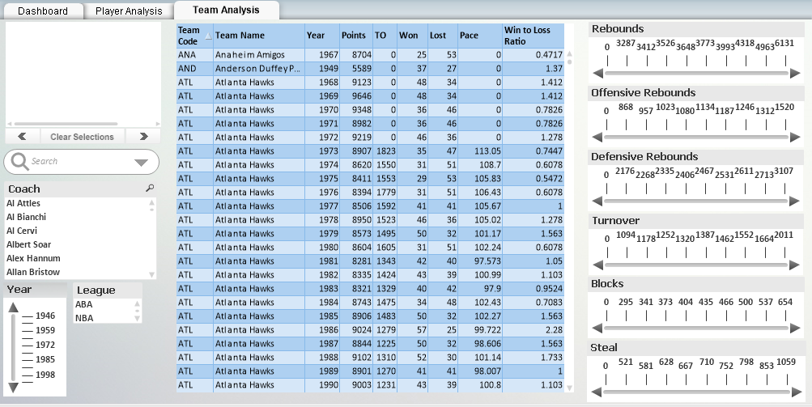
Team Analysis:

Slide 7
Team Analysis:
Current Selection with clear, back and forward selection is added to perform respected operations
Team information is shown in tabular format. This information can be filter based on rebounds, turnover, Blocks, and Steal in range format
Multiple filters can be selected in different range
Team information can be filtered using coach field
Records can be search using coach and team name
Team performance can be measured using Win to Loss ratio. Ratio less than 0 indicates team has lost more matches

Slide 8
Problem Faced:
Fields in current selection region and search section are not label but column fields. Need to change the fields in table definition

Slide 9
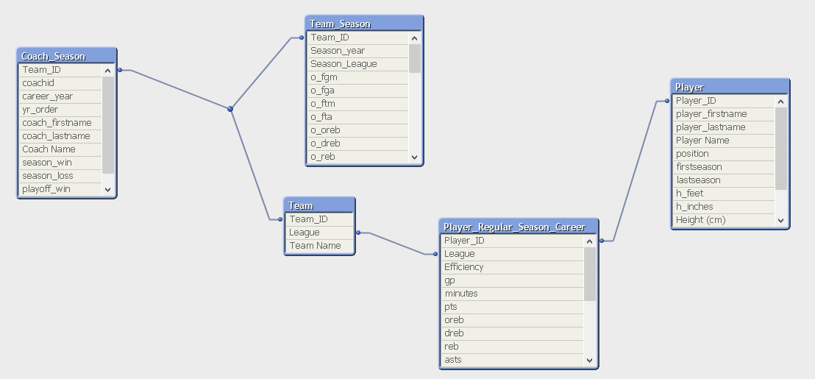
Design

Slide 10
Findings & Recommendation
Findings:
NBA has played more matches than ABA
Wining % is maximum for PTP
Kareem Abdul- jabbal is more efficient and Bob Dille
Heighted players played at C position
Win to Loss ratio is maximum for CHI team and minimum for PHI
Recommendation:
Findings can be explored in detailed to find more specific insights

